Slide 1
Marketing Analytics
Discriminant Analysis
Priyanka Shrivastava, PhD
St. Mary’s college of California

Slide 2
Discriminant Analysis: Application
Popular technique in doing Segmentation when we have available data
Steganography – It is the art and science of writing messages in such a way that no one apart from sender and intended recipient, suspects the existence of message
Classification – Predict class membership
Predictor Importance- Finding relative importance of factors that discriminate between two classes

Slide 3
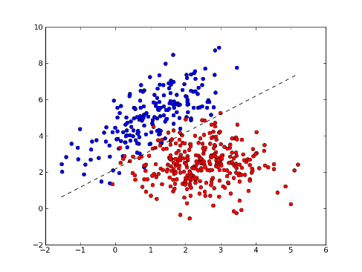
Discriminant Analysis: The Logic
Find a line that separates the two classes and is equally distant from two class centers

Slide 4
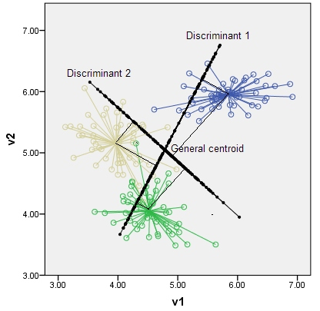
Discriminant analysis : Classification Logic
Centroid for each class is calculated
It is average of mean values of data points in each class (mean of v1 and v2 in each class)
To classify the new data point goes to which class – we use statistical distance called “Mahalanobis Distance”

Slide 5
Measuring distance: Euclidean Distance
Caselet: During admission cycle everyyear of an university, Students send application. Their application is reviewed. Some get short selected for the interview. Out of these, some students accept the university and some reject the university. Can there be a better way to target them and send offer to only selected students so that the acceptance rate of university increases
Single Predictor: CGPA
Distance of student with CGPA= 6.9 to each class
 | Non- Acceptors | Acceptors
Mean of CGPA | 7.8 | 6.1
Distance = I 6.9 – 7.8 I (Non- Acceptor) = 0.9
Distance = I 6.9 – 6.1 I (Acceptor) = 0.8

Slide 6
Euclidean distance with multiple predictors
 | Non- Acceptors | Acceptors
Mean of CGPA | 7.8 | 6.1
No. of years of experience | 3.1 | 4.5
A student with mean CGPA of 6.9 and no. of years of experience as 3.5 years
Euclidean distance in this case will be:
Non-acceptors= Square root ( 6.9-7.8)² + (3.5-6.1)²
Acceptors= Square root ( 6.9-6.1)² + (3.5-4.5)²

Slide 7

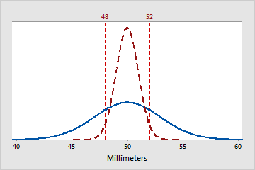
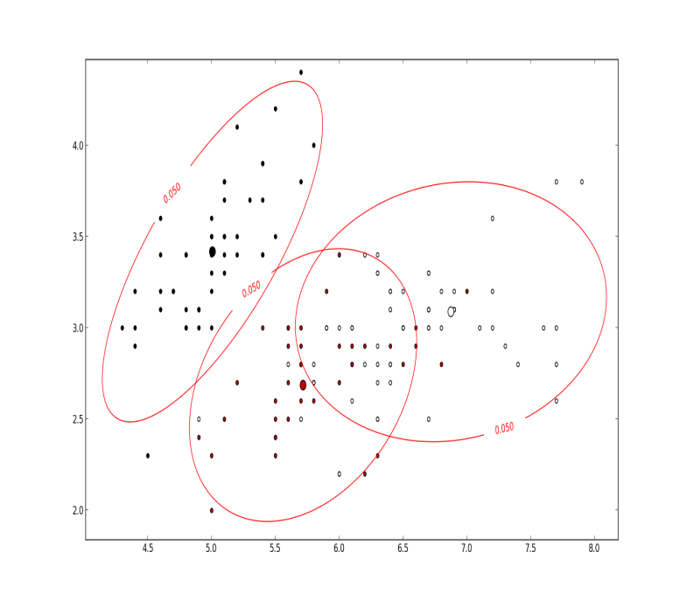
Euclidean Distance: Problems
Variance of Variables
Scale differences
Correlation between variables

Slide 8
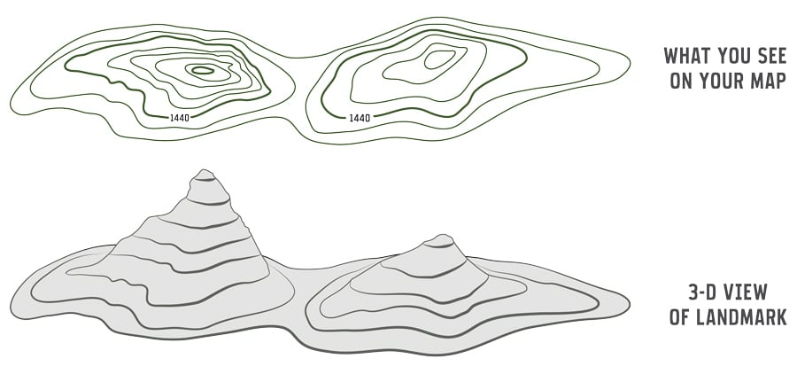
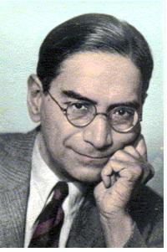
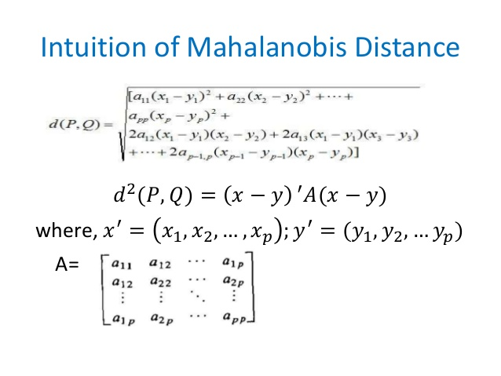
Problems of Euclidean distance can be handeled by Mahalnobis distance
Prasanta Chandra Mahalanobis
Indian scientist
Prasanta Chandra Mahalanobis OBE, FNA, FASc, FRS was an Indian scientist and applied statistician. He is best remembered for the Mahalanobis distance, a statistical measure and for being one of the ...Wikipedia

Slide 9
Classification function
It is linear combination of predictors
Discriminant Analysis Output
Variables | Accept | Reject
Constant | -6.587 | - 3.451
No. of years of exp | 0.0857 | 0.03456
Performance in last exam (CGPA) | 0.2547 | 0.11084
“No. of classification functions = No. of classes”
Mr. Vineet has 12 years of experience and CGPA in his degrees is 7.8, we need to find out whether he would accept or reject admission in this institute
CS (Accept) = -6.587 + 0.857* 12 + 0.2547* 7.8
CS (Reject)= -3.451 + 0.03456* 12 + 0.11084* 7.8
Classification scores are used to compute membership probabilities
P( Accept) = Exp ( CS(accept))
Exp (CS(accept)) + Exp(CS(reject))

Slide 10
Ranking Predictor importance using classification function
Variables | Accept | Reject
Constant | -7.587 | - 5.451
No. of years of exp | 0.1857 | -0.0456
Performance in last exam | 0.0547 | 0.01084
Steps Involved
Run Discriminant Analysis using standardized scores
Find the difference between coefficients for each variable
Variables with highest difference is most important

Slide 11

Caselet : Personal Loan offer
As part of customer acquisition efforts, Bank of America, plans to run a campaign for current customers to purchase a loan.
To improve target marketing, they want to identify the customers, most likely to accept the loan offer.
They have data of previous campaigns on 5000 customers where 480 customers accepted the offer

Slide 12
Personal Loan Data Description
ID | Customer ID
Age | Customer’s Age in completed years
Experience | No. of years of professional experience
Income | Annual Income of the customer ($000)
Family | Family size of the customer
CCAvg | Average spending of Credit Card per month
Education | Educational Level
Personal Loan | Did the customer accept personal loan offer in last campaign
Online | Does the customer use internet banking facility?
File: “Personal-Loan-Discriminant.xls”

